Slide 1
Bank Customer Churn Analysis
Predicting who leaves — and why — using 10,000 real customer records
Notes:
I'm walking you through a full customer churn analysis I built for a European retail bank. Churn means a customer closing their account and leaving. I'll cover what we set out to do, the dataset, how we cleaned and prepared it, what we found, the machine learning model we built, and what the bank should do next.

Slide 2
01
Project Objective
Who is leaving the most — and what do they have in common?
Can a machine learning model predict who's likely to leave next?
What should the bank actually do about it?
Why it matters
Replacing a lost customer costs far more than keeping an existing one. Most banks don't know who's about to leave until it's too late — this project turns that blind spot into targeted, actionable retention.
2
Notes:
Banks lose money every time a customer leaves — replacing a lost customer costs far more than keeping an existing one. The problem is, most banks don't know who's about to leave until it's too late. This project had three goals: figure out which types of customers are leaving the most, test whether a computer program can actually predict who's likely to leave next, and turn whatever we find into real, practical actions a retention team could act on immediately.

Slide 3
02
Dataset Used
Bank Customer Churn Modelling — Kaggle
10,000
3
11
Customer records
Countries: FR, GER, SPN
Features used
Fields: Credit Score, Age, Tenure, Balance, NumOfProducts, HasCrCard, IsActiveMember, EstimatedSalary
Target variable: Exited (1 = churned, 0 = retained) — this is what we're predicting
3
Notes:
I used the Bank Customer Churn Modelling dataset, sourced from Kaggle and originally derived from European retail banking records — 10,000 real customer records across three countries: France, Germany, and Spain. Each row is one customer, with fields like credit score, age, tenure, balance, number of products held, activity status, and estimated salary. The column we're trying to predict is Exited — whether that customer left the bank.

Slide 4
03
Data Cleaning Process
1
Removed identifiers
Dropped RowNumber, CustomerId, Surname — no predictive value, .drop(columns=...)
2
Checked duplicates
0 found via .duplicated() — auto-removal built in with .drop_duplicates()
3
Checked missing values
0 found via .isnull() — conditional imputation (median/mode) built in
4
Standardized text fields
Trimmed whitespace on Geography and Gender using .str.strip()
4
Notes:
Before analyzing anything, I had to make sure the data was trustworthy. First, I removed columns with no predictive value — RowNumber, CustomerId, and Surname — since a customer's name or ID tells a model nothing about their behavior; keeping it in would just let the model memorize individuals instead of learning real patterns. Next, I checked for duplicate rows and missing values — both came back at zero, but we built in automatic fixes either way. Finally, I cleaned stray whitespace from text fields like Geography, since 'Germany ' and 'Germany' would otherwise be treated as two different countries.

Slide 5
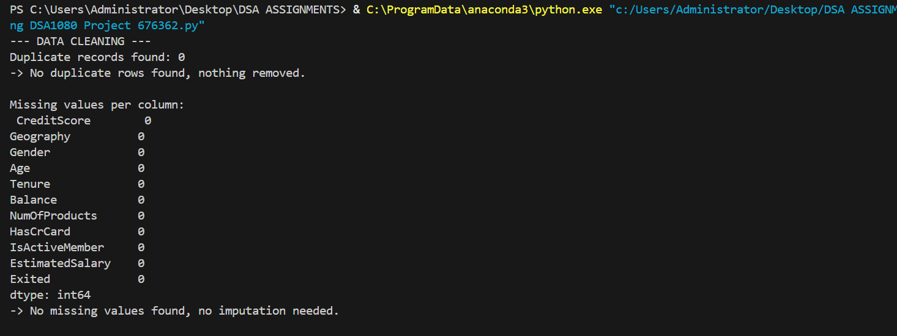

Slide 6
04
Feature Engineering & Analysis
Balance-to-Salary Ratio: wealth relative to income (+1 to salary avoids divide-by-zero)
Age Group: binned exact ages into Young Adult / Middle Aged / Senior / Elderly via pd.cut()
Filtering: isolated high-value churned customers (balance > $100k)
Sorting: identified the top 5 wealthiest customers
Group-by aggregation: churn rate by Geography, Products, Activity — the source of every headline number in this deck
5
Notes:
Beyond cleaning, I engineered two new columns. Balance-to-Salary Ratio divides a customer's balance by their salary to show how much of their wealth sits in this one bank relative to their income. Age Group used pd.cut() to bucket exact ages into life stages, making patterns easier to spot. I also used filtering to isolate high-value churned customers, sorting to find our top 5 wealthiest customers, and — most importantly — group-by aggregation, which splits thousands of rows into groups and calculates a statistic within each one. Every headline number in this presentation, like 'Germany churns at 32.4%,' came from this technique.

Slide 7
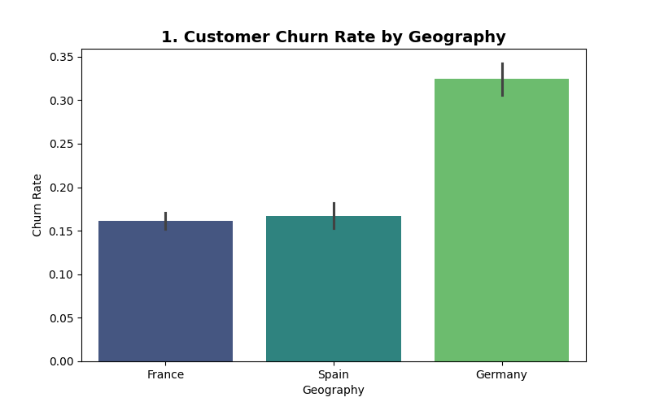
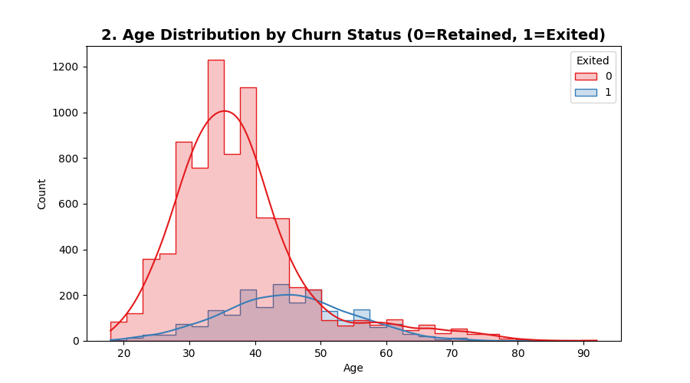
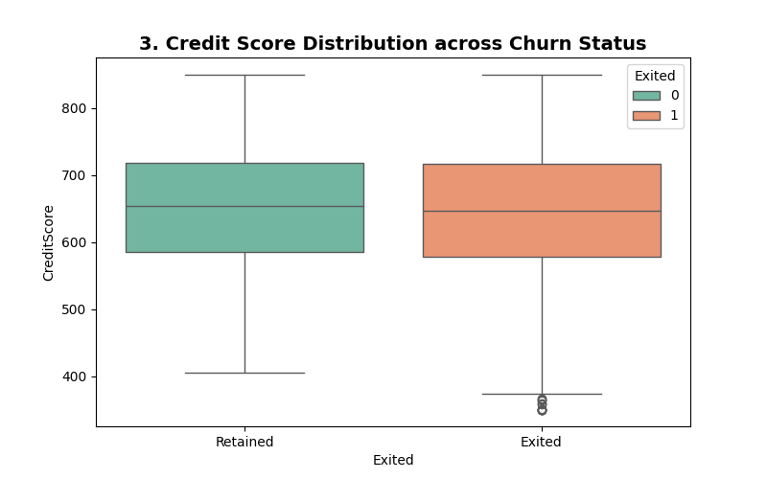
05
Visualizations — Part 1
Churn by Geography
Age Distribution
Credit Score by Churn
Bar chart — Germany 32.4% vs. France 16.2% / Spain 16.7%
Histogram — churners skew noticeably older
Box plot — retained vs. exited look almost identical
6
Notes:
Three charts here. First, a bar chart comparing churn rate by country — the right tool for comparing separate categories — showing Germany at 32.4% churn, roughly double France's 16.2% and Spain's 16.7%. Second, a histogram of age distribution, the right chart for showing the shape of a numeric spread — churned customers skew noticeably older than retained ones. Third, a box plot comparing credit score between retained and exited customers — useful for comparing spread and median at a glance — and here the two groups look almost identical, telling us credit score alone doesn't meaningfully predict churn.

Slide 8
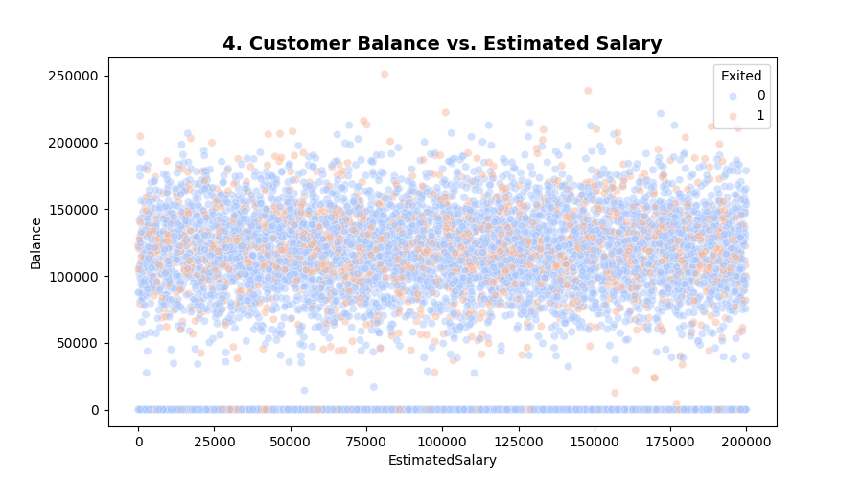
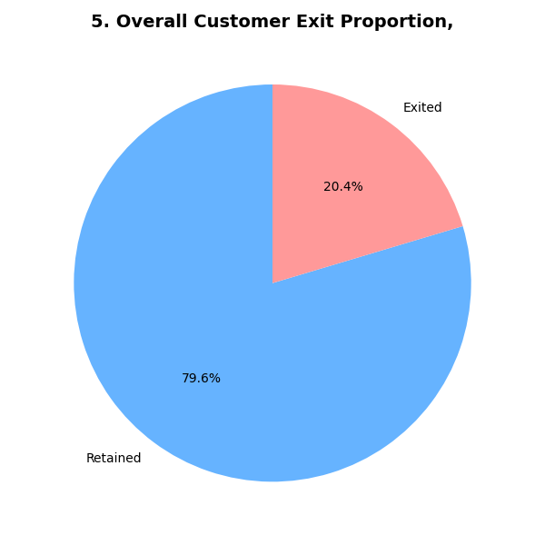
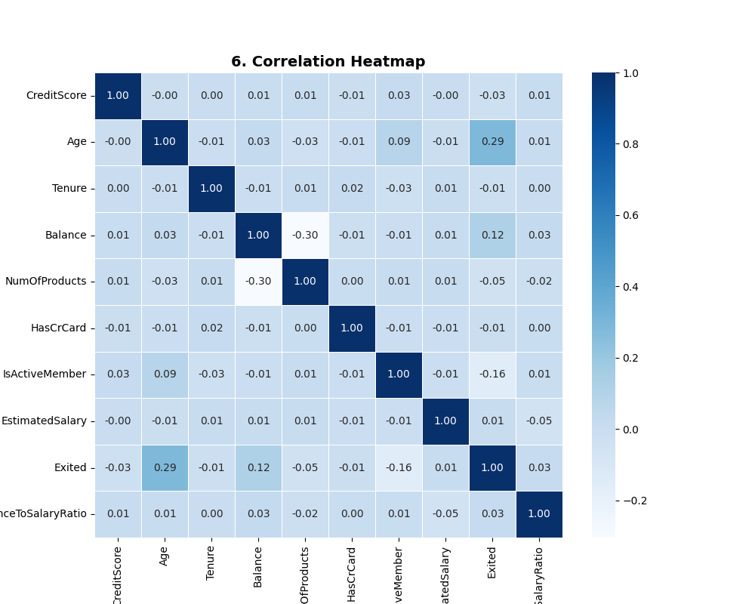
05
Visualizations — Part 2
Balance vs. Salary
Overall Exit Proportion
Correlation Heatmap
Scatter plot — no clean pattern; wealth alone doesn't predict churn
Pie chart — 79.6% retained / 20.4% exited (class imbalance)
Heatmap — Age has the strongest (still weak) link to churn
7
Notes:
Three more charts. A scatter plot of balance versus estimated salary — the right tool for spotting relationships between two numeric variables — showed no clean pattern; churners are scattered across the full range of both, so wealth alone doesn't predict churn. A pie chart showed our overall class split: 79.6% retained, 20.4% exited — visual proof of the class imbalance that matters a lot once we get to the model. Finally, a correlation heatmap scanned relationships across all numeric variables at once — Age had the strongest link to churn, but even that was weak on its own, confirming churn is driven by a combination of factors, not one single number.

Slide 9
06
Building the Machine Learning Model
Decision Tree Classifier — learns yes/no questions to predict churn
1
Encoding
Geography → one-hot encoded (no false ranking); Gender → simple 1/0
2
Scaling
StandardScaler — puts Balance and CreditScore on the same footing
3
Stratified Split
80/20 split with stratify — preserves the 79.6%/20.4% ratio in both sets
8
Notes:
I trained a Decision Tree Classifier — an algorithm that learns a series of yes/no questions about a customer to arrive at a prediction. Before training, I prepared the data with three techniques: categorical encoding, converting Geography into separate 0/1 columns via one-hot encoding, and Gender into a simple 1/0; scaling, using StandardScaler so a large-scale feature like Balance doesn't overpower a small-scale one like Credit Score; and stratified splitting, using stratify on our 80/20 train-test split to guarantee both sets kept the same 79.6%/20.4% ratio as the full dataset.

Slide 10
07
Model Results
85.6%
78.7%
40.0%
0.531
Accuracy
Precision
Recall ⚠
F1-Score
Precision: when the model predicts churn, it's right 4 out of 5 times. Recall: it only catches 4 out of every 10 customers who actually leave — missing the other 6. Because 80% of customers stayed, the model can score high accuracy just by leaning toward “stayed.” High accuracy is hiding a real weakness in catching the customers we actually care about.
9
Notes:
The model scored 85.6% accuracy, 78.7% precision, 40.0% recall, and an F1-score of 0.531. Precision tells us that when the model predicts someone will leave, it's right about 4 times out of 5. But recall tells us it only catches 4 out of every 10 customers who actually leave — missing the other 6. This gap matters: because 80% of customers stayed, the model can score high accuracy just by leaning toward 'stayed' — meaning high accuracy is hiding a real weakness in catching the customers we actually care about.

Slide 11
08
Key Findings
Geography
Germany churns at 32.4% — roughly double France (16.2%) and Spain (16.7%)
Product Count
Customers with 3–4 products churn far more than those with 1–2 — more products, more frustration
Engagement
Inactive members churn at nearly 2x the rate of active members
10
Notes:
Three patterns stood out. Geography: Germany churns at roughly double the rate of France or Spain. Product count: customers holding 3 or 4 products churn at dramatically higher rates than those holding 1 or 2 — more products doesn't mean more loyalty, it seems to mean more frustration. Engagement: inactive members churn at nearly twice the rate of active ones, making activity level our clearest early-warning signal.

Slide 12
09
Recommendations
Prioritize retention efforts in Germany — review local pricing, competition, and service quality
Audit the 3- and 4-product bundles — the single biggest churn driver found in this study
Build a proactive outreach program that flags customers the moment their activity drops
Future models should prioritize recall over accuracy — catching more real churners matters more on imbalanced data
11
Notes:
Prioritize retention efforts in Germany — investigate local pricing, competition, and service quality there. Audit the 3- and 4-product bundles, since that's the single biggest churn driver found in this study. Build a proactive outreach program that flags customers the moment their activity drops, rather than waiting until they've already left. And on the technical side, future models should prioritize improving recall — catching more real churners — over chasing higher accuracy, since accuracy alone is misleading on data this imbalanced.

